Slide 1
Course - DT228/1
Information Technology Fundamentals
INFORMATION TECHNOLOGY DISCIPLINES

Slide 2
What Disciplines?
Information Technology (IT) is an interdisciplinary field influenced by:
Computer Science,
Political Science,
Psychology,
Operational Research,
Linguistics,
Sociology,
Organisational Theory and Behaviour
Ergonomics

Slide 3
Computer Science Disciplines
Computer Science has its own disciplines:
Mathematics
Physics
Cognition
Economics
Biology (?)
and many more…
Computer Science is a powerful set of ideas for understanding almost anything in any area of science.

Slide 4
Computer Science
Computer Science has, traditionally, been concerned with the areas of:
Programming languages
Compilers
Operating systems
Algorithms
Databases
…with an emphasis on making computers useful to society (mainly business and government).

Slide 5
Computer Science (2)
Computer Science is evolving:
Tracking the flow of ideas in scientific literature.
Tracking the evolution of communities in social networks (to apply marketing strategies, for example).
Extracting information from unstructured data sources (EG data capture ‘on-the-fly’ while applications are running. Think ‘cookies’).
.../ continued

Slide 6
Computer Science (3)
Processing massive data sets and streams
Extracting signals from noise (data capture)
Dealing with high ‘dimensional data’ and ‘dimension reduction’ (data targeting)
The field will become much more application oriented – systems will become specialised and specific

Slide 7

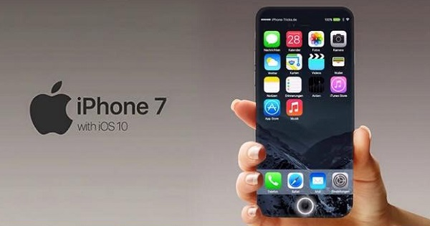
Computer Science (4)
What is driving this evolution?
The merging of computing and communication,
The wealth of data available in digital form,
Networked devices and sensors.

Slide 8
Computing Revolution
INFORMATION
REVOLUTION
INTELLIGENT
SYSTEMS
REVOLUTION
Internet Smart phones
World Wide Web Smart appliances
Wireless Telephony Smart vehicles
Fax Smart lifts (Elevators)
Digital Libraries Smart robots
Data Mining Intelligent manufacturing
Information Retrieval Smart Quality Control
… Smart search engines
Expert Systems

Slide 9
Intelligence
Intelligence is the computational part of the ability to achieve goals in the world.
Varying kinds and degrees of intelligence occur in people, many animals and some machines.

Slide 10
What is Intelligence?
The ability to interact with the real world - to perceive, understand, and act. For example;
speech recognition and understanding and synthesis
image understanding
ability to take actions, have an effect
Reasoning and planning;
modeling the external world, given input
solving new problems, planning and making decisions
ability to deal with unexpected problems, uncertainties
Learning and adaptation;
humans are continuously learning and adapting
our internal models are always being “updated”
EG, a baby learning to recognise and categorise animals

Slide 11
Artificial Intelligence
Artificial Intelligence (AI) is the science and engineering of making intelligent machines, especially intelligent computer programs. It is related to the similar task of using computers to understand human intelligence, but AI does not have to confine itself to methods that are biologically observable.

Slide 12
Artificial Intelligence – Machine Intelligence Quotient
Machine intelligence (MI) is related to a machine’s mimicking knowledge about the world.
To conceptualise MI, computing and policy professionals need to measure intelligent machines. Multiple perspectives, machine intelligence measurement (MIM), and fuzzy set theories might be used to determine the commonalities and differences among diverse machine intelligence quotient (MIQ) theories and the means to synthesize them.
MIQ places a measurement number (metric) on machine features that are parallel to human intelligence.
The next slide lists the ‘dimensions’ of machine intelligence quotient.

Slide 13
Artificial Intelligence – Machine Intelligence Quotient (2)
Handwriting recognition
Speech recognition
Natural language understanding
Summarization
Disambiguation
Image understanding and pattern recognition
Diagnostics
Unstructured storage and retrieval of information
Execution of high level instructions (expressed in NL)
Learning
Reasoning
Planning
Problem solving
Decision making

Slide 14
Artificial Intelligence Disciplines
Philosophy
Mathematics
Probability/Statistics
Economics
Neuroscience
Psychology/Cognitive Science
Computer Engineering
Control Theory
Linguistics

Slide 15
Computer Progress
There have been general failures and successes in some of the predictions made about information systems and computing since the 1950s and 60s.
Notable failures (or limitation) include the automation of driving in city traffic and robot servants.
Successes include the moon landings, GPS systems, search engines and bioinformatics.

Slide 16
Bioinformatics
Bioinformatics is the application of computational tools on molecular data, including the means to acquire, analyse or visualise such data.
Large databases that can be accessed and analyzed with sophisticated tools have become central to biological research and education.

Slide 17
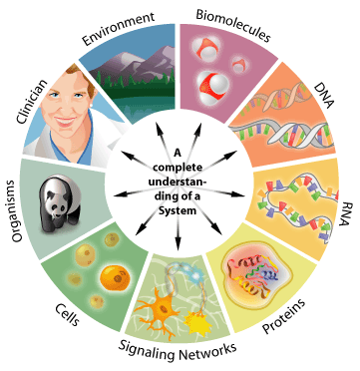
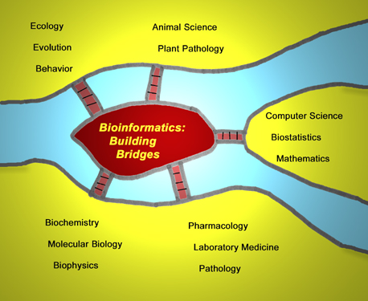
Bioinformatics (2)

Slide 18
Bioinformatics (3)
The information content in the genomes of organisms, in the molecular dynamics of proteins, and in population dynamics, to name but a few areas, is enormous. Biologists are increasingly finding that the management of complex data sets is becoming a bottleneck for scientific advances. Therefore, bioinformatics is rapidly become a key technology in all fields of biology.

Slide 19
Bioinformatics (4)
The present bottlenecks in bioinformatics include:
the education of biologists in the use of advanced computing tools,
the need to recruit computer scientists into this evolving field,
the limited availability of developed databases of biological information and
the need for more efficient and intelligent search engines for complex databases.

Slide 20
Political Science
Political Science is the study of State, Government and Politics (and includes the concepts of governance and administration).
State relates to a territory’s population, Government relates to the will of the people, through political organisation, and Politics relates to the activities and rules that shares the power among the people (?) in the territory.

Slide 21
Political Science (2)
This science has a huge amount of information – static and dynamic.
Information Technology is a valuable field to Political Science as all modern states (nations) have grown in size and capacity in recent years. Nations have extended their roles and responsibilities from primarily defence and law and order concerns to concerns about everyday economic management, welfare services and the regulation of many aspects of social life.

Slide 22
Political Science (3)
Governance and administration is where the information technology and systems are needed.
Irish government departments – 16, all with complex information systems, including:
Agriculture, Food and the Marine | Jobs, Enterprise and Innovation
Defence | Justice and Equality
Environment, Community and Local Government | Education and Skills
Finance | Health
Foreign Affairs and Trade | Social Protection

Slide 23
Psychology
Information Technology supports the discipline of Psychology:
the teaching of psychology, and developing advanced applications -
EG tutorials and courseware
allowing the creation of a peer-reviewed journal
Virtual Reality Modelling Language for virtual reality simulations
…/ continued

Slide 24
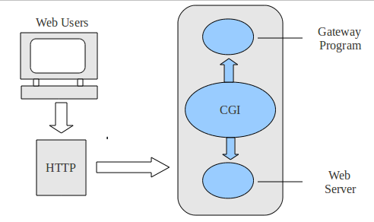
Psychology
mental health and psychological resources,
EG Databases
Common Gateway Interfaces
(CGIs)
The World-Wide Web (WWW) allows for scientific communication, including the exchange of peer-refereed scientific journals

Slide 25
Operational Research
Operational Research (OR), or Operations Research, is a scientific discipline dealing with the application of advanced analytical methods to help make better decisions. (Also known as Management Science or Decision Science.)
OR employs techniques from other mathematical sciences, such as mathematical modelling, statistical analysis and mathematical optimisation.

Slide 26
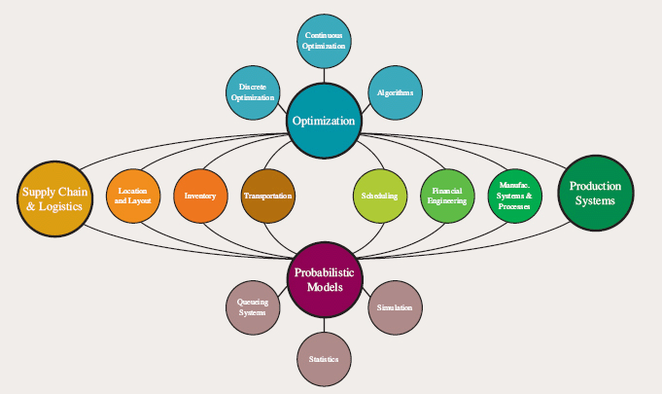
Operational Research (OR)
Operational research needs information systems to ‘do its work’ in specific areas of science and society - including, among others;
Ecology,
Transportation,
Safety and/or Reliability,
Urban Planning,
Economics,
Inventory Control,
Investment Strategy and
Logistics (including Reverse Logistics).

Slide 27
Linguistics
Linguistics is the study of knowledge systems for expression of ideas, hypotheses, emotions, desires…
The study of language and its structure includes the study of morphology, syntax, phonetics and semantics.
Morphology = the forms of words
Syntax = sentence structure of words and phrases
Phonetics = speech sounds
Semantics = the meanings of words and phrases

Slide 28
Linguistics (2)
Linguistic information systems are used for:
Data management
Speech analysis and phonetics
Phonology and morphology
Syntax and grammar description
Lexicon (word list)
Text analysis
Language survey and comparison

Slide 29
Sociology
Sociology – the study of the development, structure and functioning of human society – often with a study focus on social problems.
Sociological data sets - analysed by computer procedures to produce results that reflect the intricacy of social life.
Computers are also used to conduct simulations of social processes based on mathematical models and to collect the data for analysis.
Portable computers for field studies, with new research opportunities.

Slide 30
Sociology (2)
Technology for research methods to analyse and model social phenomena:
computer simulations,
Artificial Intelligence (AI),
complex statistical methods, and
analytic approaches –
EG social network analysis
computational sociology develops and tests theories of complex social processes through bottom-up modelling of social interaction.

Slide 31
Organisational Theory and Behaviour
Organisational theory - the study of formal social organisations such as businesses and bureaucracies, and their interrelationship with the environment in which they operate.
Organisational behaviour - the field of study that investigates how organisational structures affect behaviour within organisations.
(Information systems will not be unlike those of Sociology.)

Slide 32
Organisational Theory and Behaviour (2)
Organisational Theory and Behaviour (OT & B) subcomponents:
Group dynamics
Organisations’ and industries’ structures, strategies and contingencies
Leadership, decision making, team building, motivation and job satisfaction are all facets of OT & B.
Organisations are viewed as open systems, continually interacting with their environment. They are in a state of dynamic equilibrium as they adapt to environmental changes.

Slide 33
Organisational Theory and Behaviour (3)
Information systems for organisations in relation to organisational behaviour:
Human Resources System (database)
Customer Relationship Management Systems
Business Intelligence Systems
Knowledge Management Systems

Slide 34
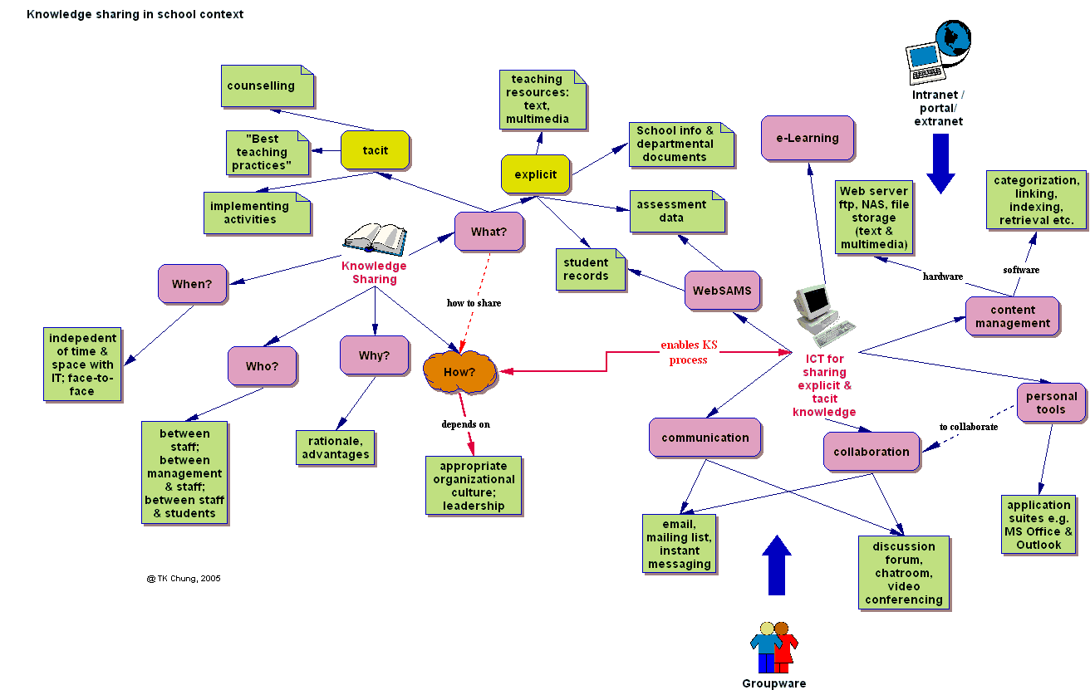
A College Organisational System

Slide 35
Ergonomics
Ergonomics - the study of people's efficiency in their working environment.
This discipline is about designing for people, wherever they interact with products, systems or processes.
Ergonomics is often related to ‘user centredness’. (Sound familiar? Week 8?)
Sometimes termed ‘Human Factors’

Slide 36
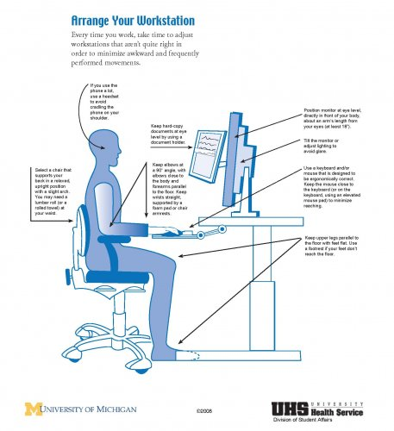
Ergonomics (2)

Slide 37
Ergonomics (3)
Using computers can, when proper ergonomics are not considered, cause:
Tension in your back, neck, shoulders
Aching hands or wrists
Headaches
Pressure due to eye strain
An improper computer workstation setup can lead to injuries.

Slide 38
Ergonomics (4)
Properly adjust your workstation
Monitor, keyboard, mouse, chair, etc.
Height: keyboard just below elbows
Feet flat on floor or supported by foot rest
Lean back into the chair
Lumbar support should maintain “S” curve
Shoulders, neck, arms relaxed
Use the arm rests ONLY when resting, never while keying or mousing

Slide 39
Keyboard Ergonomics
Flat if on the desk – don’t use the “feet”
Negative tilt if on tray
Sloped away from the body
Keep wrists STRAIGHT, fingers relaxed
It is okay to use a palm rest. Only rest your PALMS on it.
Never rest your wrists on any surface.

Slide 40
Carpal Tunnel Syndrome
Carpal tunnel syndrome (CTS) is a relatively common condition that causes a tingling sensation, numbness and sometimes pain in the hand and fingers.
Carpal tunnel syndrome is caused by compression of one of the nerves that controls sensation and movement in the hands (median nerve).
I have seen this happen to colleagues due to mousing and typing.

Slide 41
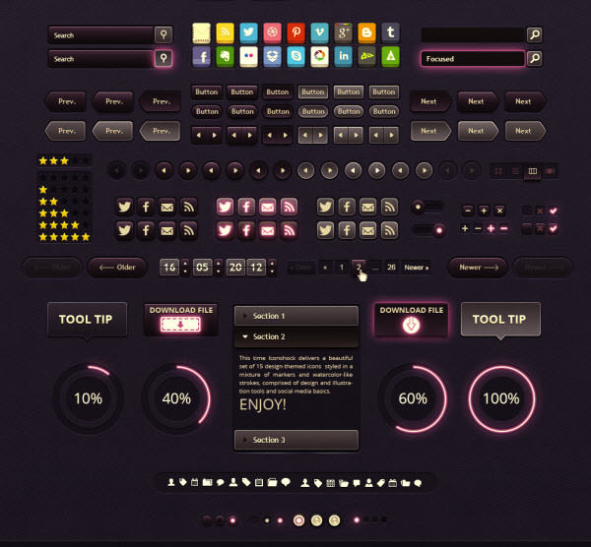
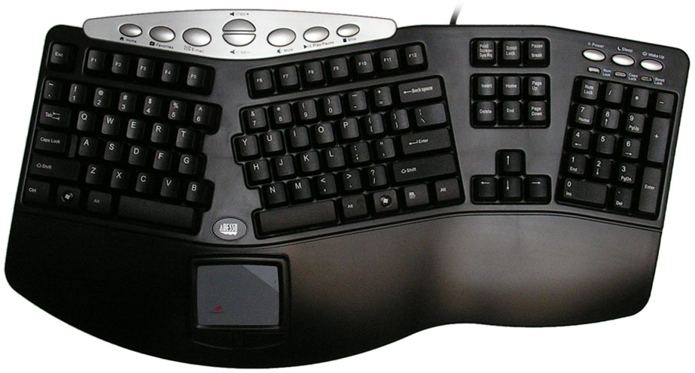

Ergonomic Design
Design is often the answer to ergonomic computer systems:
Graphical User Interface
Keyboard
Mouse
GUI Set

Slide 42
Up Next
Next week’s lecture title is:
Information Technology Domains

